Slide 1
Idea/Approach Details
Ministry/Organization name: Ministry Of Rural Development
Problem Statement: Automation mechanism for image capturing, processing, standardization, evaluation, classification , leading to better
decision leading to better decision making results for various programs.
Team Name : TheRavens
Team Leader Name : Manish Choudhary
College Code : 1-3513406211

Slide 2
Idea Description
Idea :
The Idea is to build a web-application which have various portal for different Government programs, each portal have image capturing and different document uploading features. The validation and type defining of images are done by ML (Google Vision AI) , Deep Learning Algorithm (CNN).
Idea Description :
A Hybrid web based application will be created.
The application will have individual portal for every Government Programs.
Each portal have access to features/tools like
- Image Capturing tool with Geo tag.
- Documents and Images Uploading Features

Slide 3
Idea Description (continue):
The application automatically validate and define the type of images.
Object
Labels
Logos
Text
Properties
Validation and types of information will show on portals.
Technical Approach :
Image Classification / ML Process : Google Vision AI/CNN Algorithm
Geo-Tag (Location Identification) : Geotagger python framework
OCR (Documents OCR Process) : Tesseract python framework

Slide 4
SOLUTION
As our idea is describe in previous slide, that we make a platform which will works as a bridge to fulfill the gaps between digital and physical workflows. With newly found encouragement to be creative, people are finding new ways to deal with the current reality.
Even though the construction industry has traditionally been slow to adopt the new technology, our current reality means we are leaning on it more than ever to be efficient and remain productive.
It will be also helpful for Municipalities to updating their process for permit application and e-procurement to accommodate new technology.

Slide 5
SOLUTION continued..
Through this platform we can capture more data in the field, the more information can be shared with the team members who are currently not on sites. The daily reporting of tasks completed in the field becomes key.
And if an inspector don’t need to be on-site, it can be challenge to get timely information to make important decisions. So through this platform the inspector can also check the images validation.

Slide 6
POST INSPECTION WORKFLOW :
As after an inspection, electronics records help make it all happen.
When inspection notes are digital and added to working plans , there is no delay waiting for a report from an inspector. They’re immediately available to act on.
As it is a cloud based platform, which means all photos and annotations with labels, OCR and image size can remain permanently within the job file. They are also within the context of the sites progress so the end user can see what happened on the work after the inspection.
This platform will be deals with balancing efficiency with regulations which means the contractors, municipalities and the public are confident with the outcomes.

Slide 7
Details attached with Uploaded Media
IP
City
Region
Country
Location
Latitude & Longitude
Postal/zip code
Used For Identity and Fraud Detection.

Slide 8
1. Structured Formatted OCR Text Extraction
Text Extracted From Images/Pdfs under any Scheme will be stored as structured format like data frame or in excel or csv format.
And this will be used at Admin side for validating the Employment Identity or details.
2. Images Compression
High Resolution Compression (Slow Processing)
Using ML Algorithm
Low Level Compression (Fast Processing)
Simple PIL method

Slide 9
Idea Description (continue):
Datasets
Training
User Side
Admin Side
Images
CNN Module
Docs
User Dataset
Google Vision AI Algos
Admin
Dataset

Slide 10
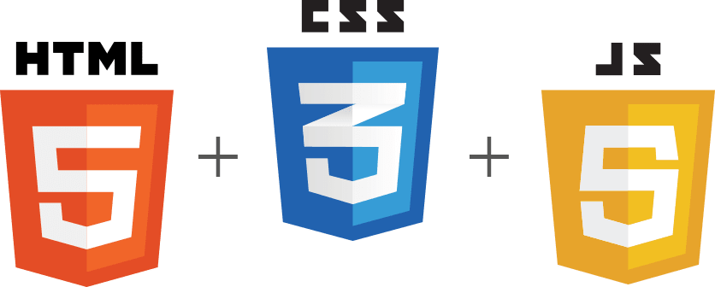

Technology Stack :
FRONTEND
BACKEND
Programming Languages :
- JavaScript
- HTML5
- CSS 3
JavaScript Framework :
- Angular
- Jquery
CSS Framework :
-Bootstrap
(Hybrid App)
Programming Languages :
- Python
Python Framework :
- Flask
Image Processing –
OpenCV Python
Google Vision AI
CNN
OCR and Geo-Tag Python :
- Tesseract OCR and Geotagger

Slide 11
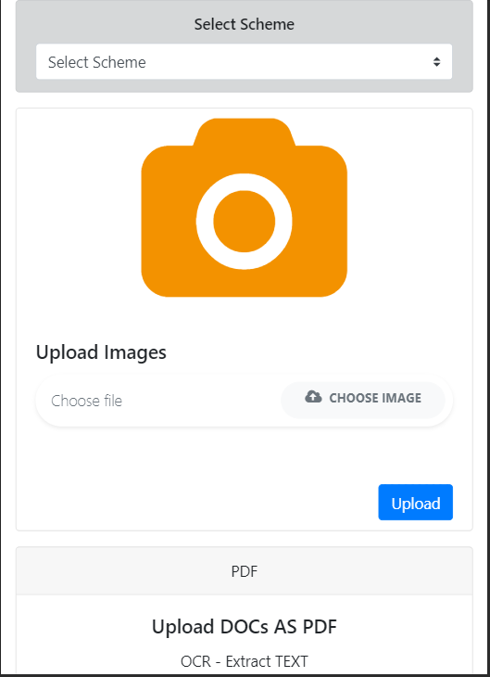
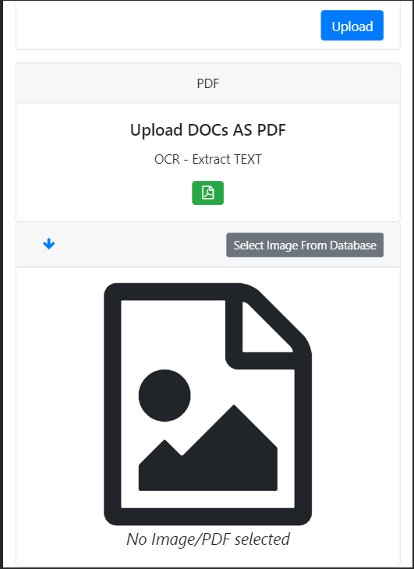
Client/User Side

Slide 12
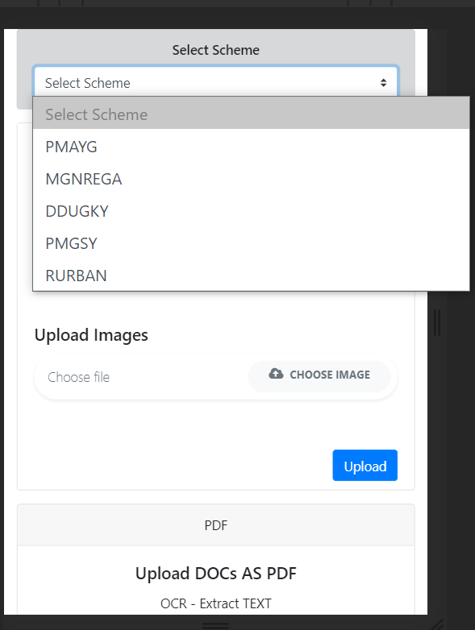
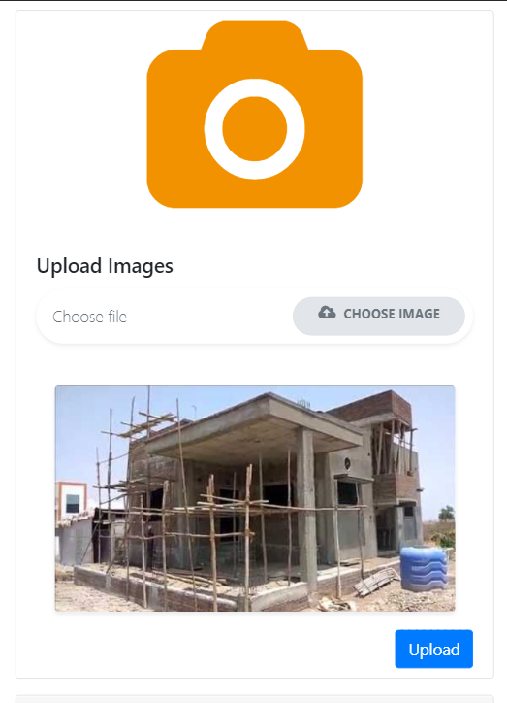
Client/User Side

Slide 13
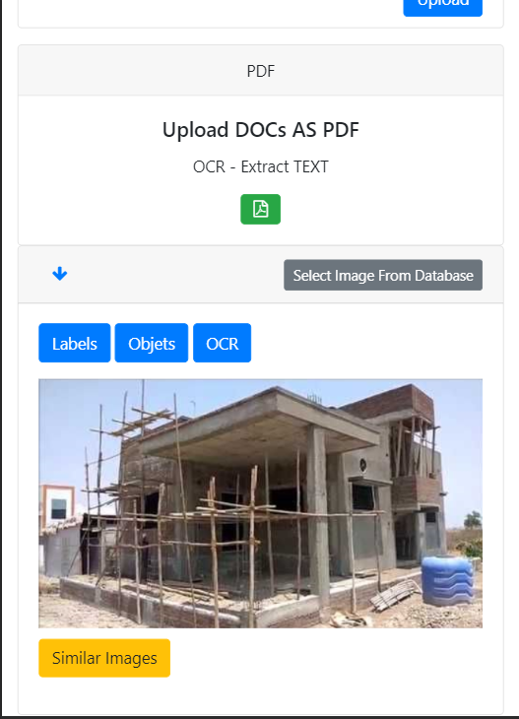
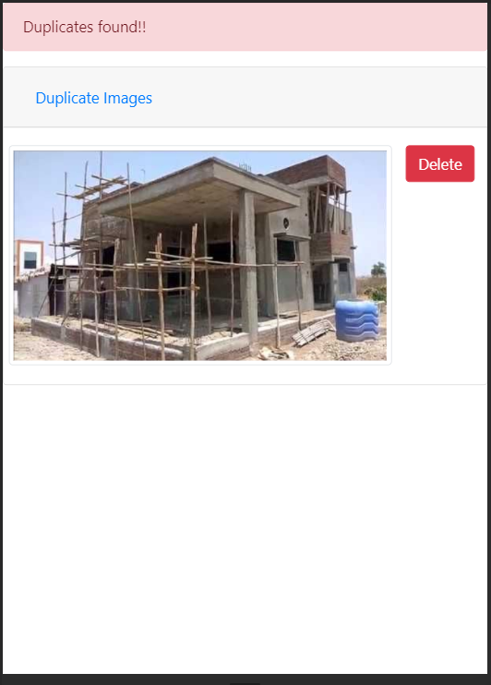
Client/User Side

Slide 14
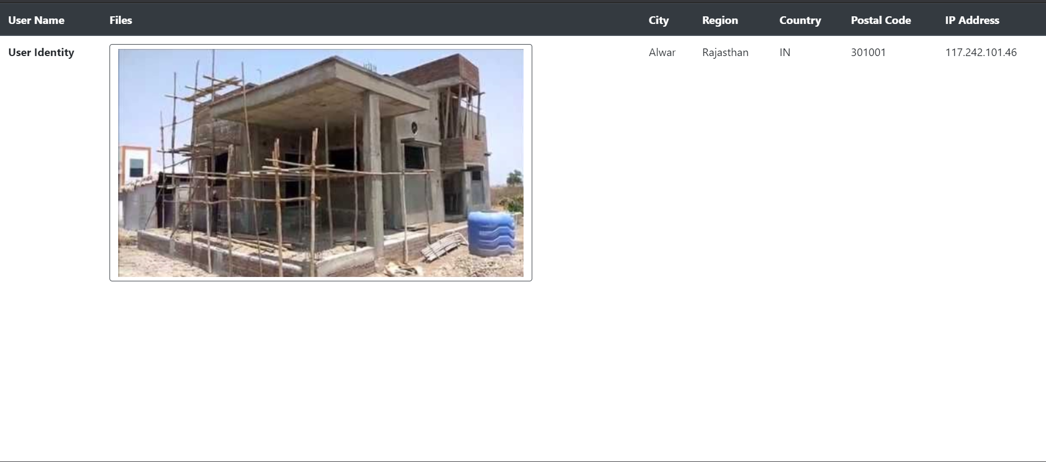
Admin Side - Inspectors

Slide 15
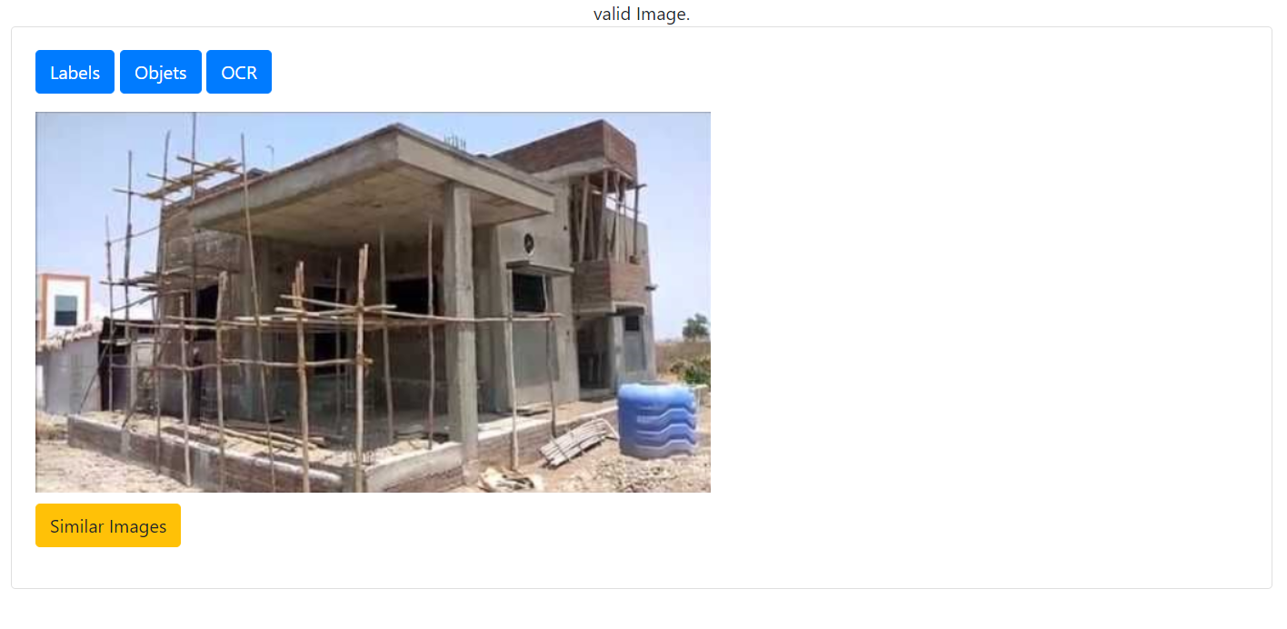
Admin Side - Inspectors

Slide 16
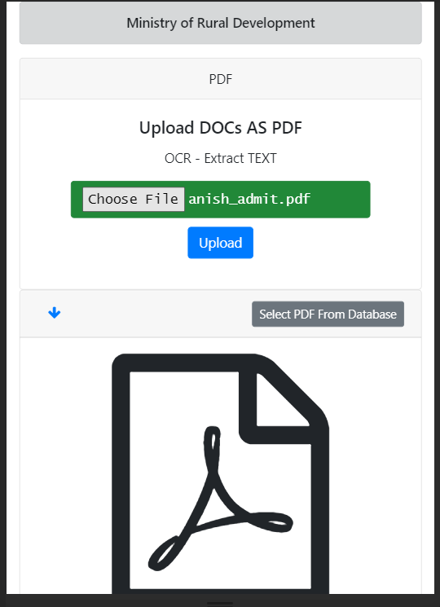
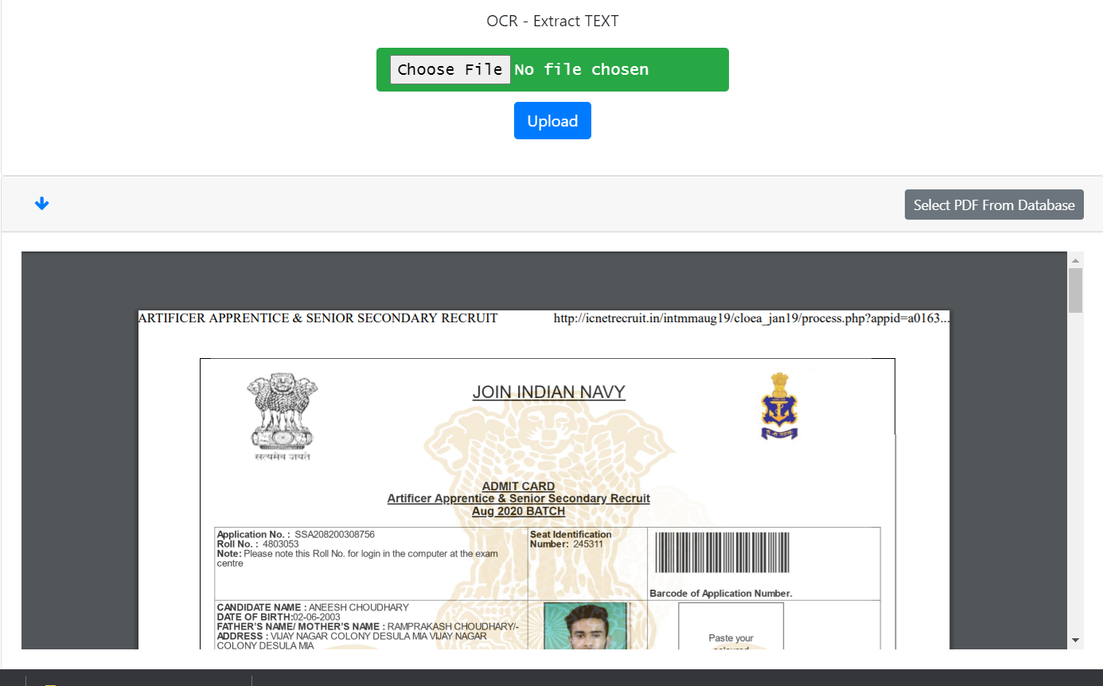
Client Side - Users

Slide 17
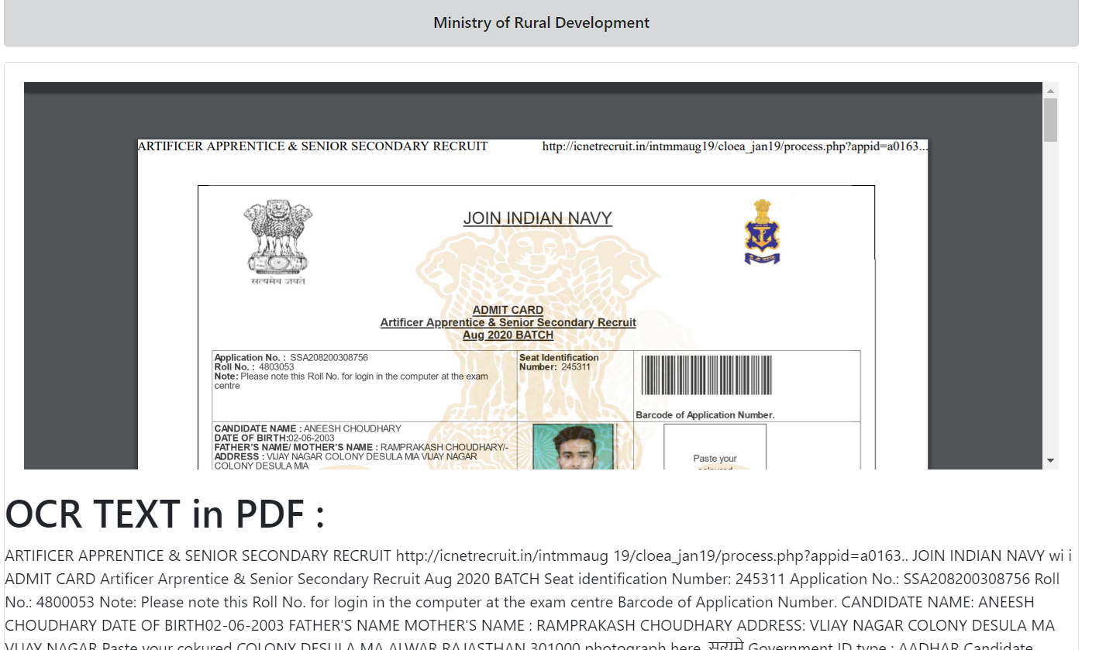
Admin Side - Inspectors

Slide 18
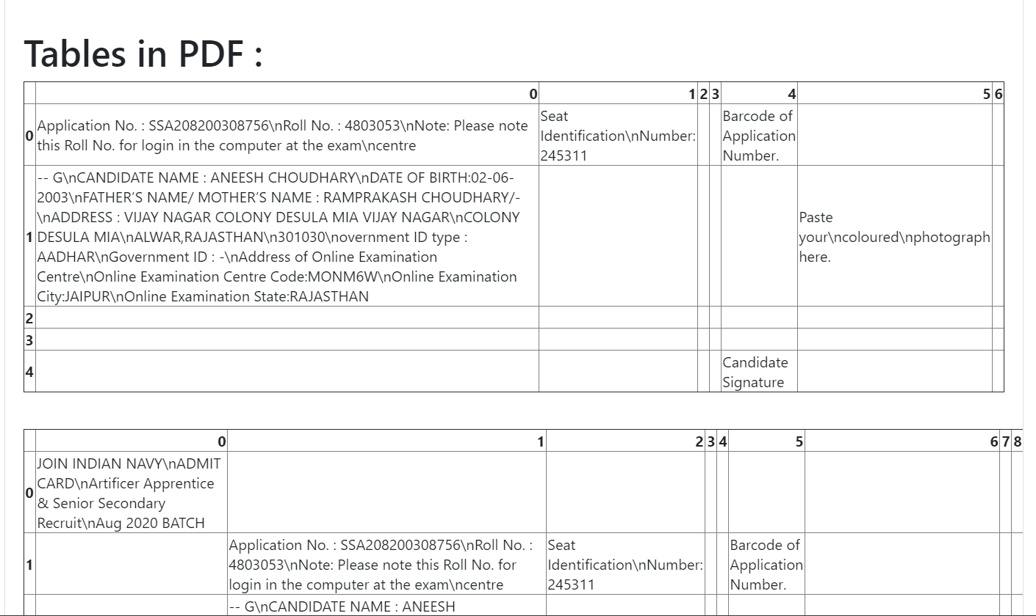
Admin Side - Inspectors

Slide 19
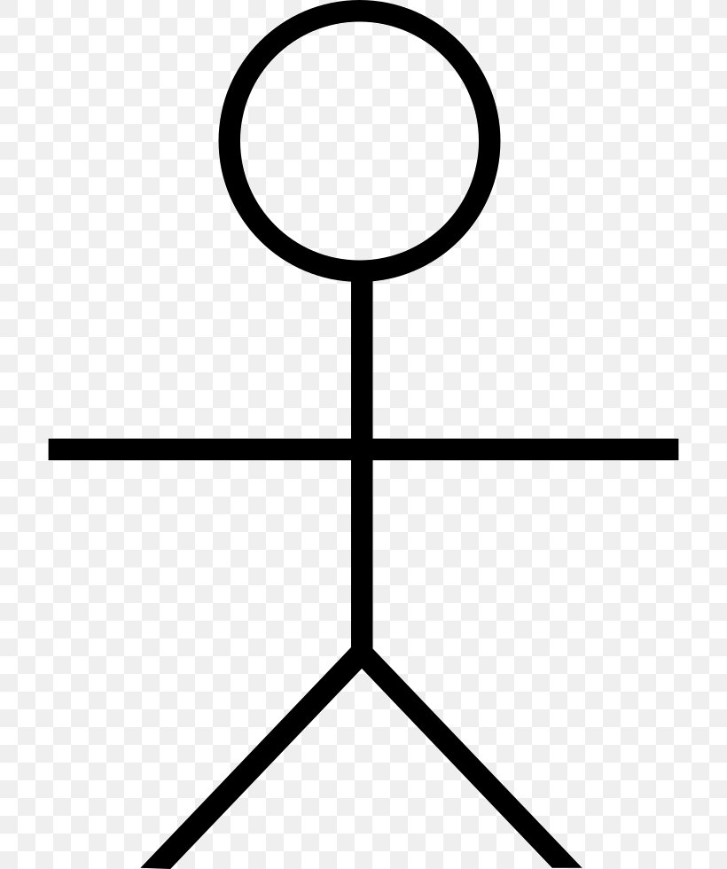
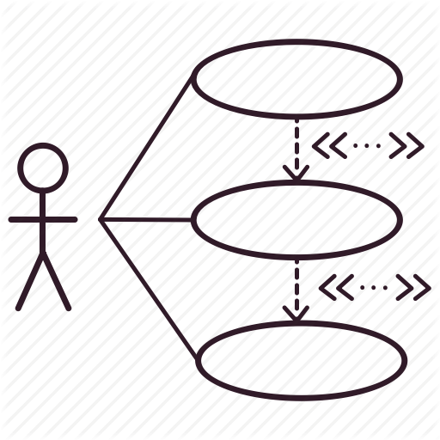
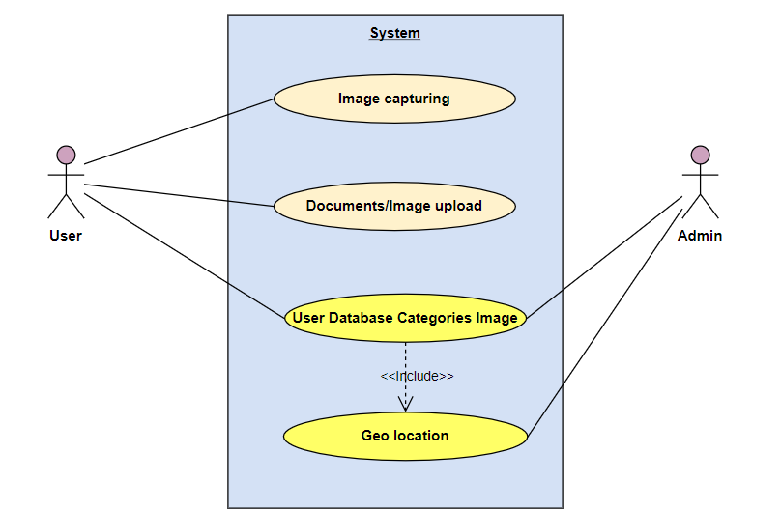
Use Cases :
Actors
Use case Diagram
User : user who will upload Documents and Images and capture Images through Camera.
Admin : User who can see manually all uploaded data and verification details.

Slide 20
Dependencies:
CLIENT SIDE
Mobile or Computer Device
Web-Browser or Mobile App
Internet
SERVER SIDE
Large Scale Database
Cloud Storage

